Slide 1
Mission Planner
An overview from software basics to SITL simulations

Slide 2
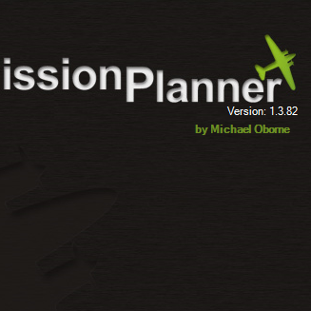
[Mission Planner Demo]

Slide 3
Overview
Review the importance of GCS software in UAV Operations
Develop an understanding of the features and interface of “Mission Planner”.
Learn how the ArduPilot SITL can be used for testing and development of Autonomous UAV solutions.
Explore Mission Planner and the SITL simulator through a series of Practical exercises

Slide 4



Background Information
Ground Control Station:
Displays vital statistics and information to UAV operators.
Telemetry.
Control of autonomous missions.
Custom code to allow full automation.
Various Software Options:
Mission Planner (We Use This!)
QGroundControl
APM Planner
UAV
GCS Laptop
Remote Pilot
Custom Control

Slide 5
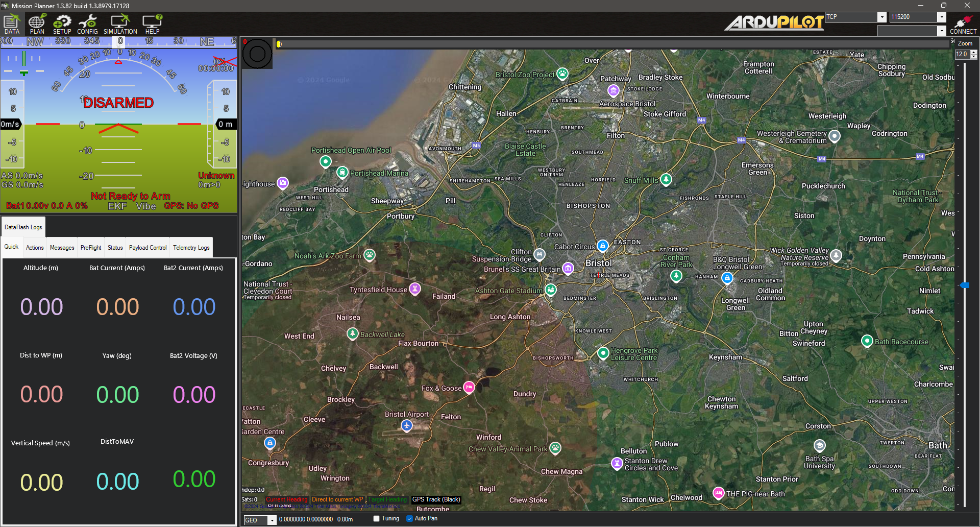
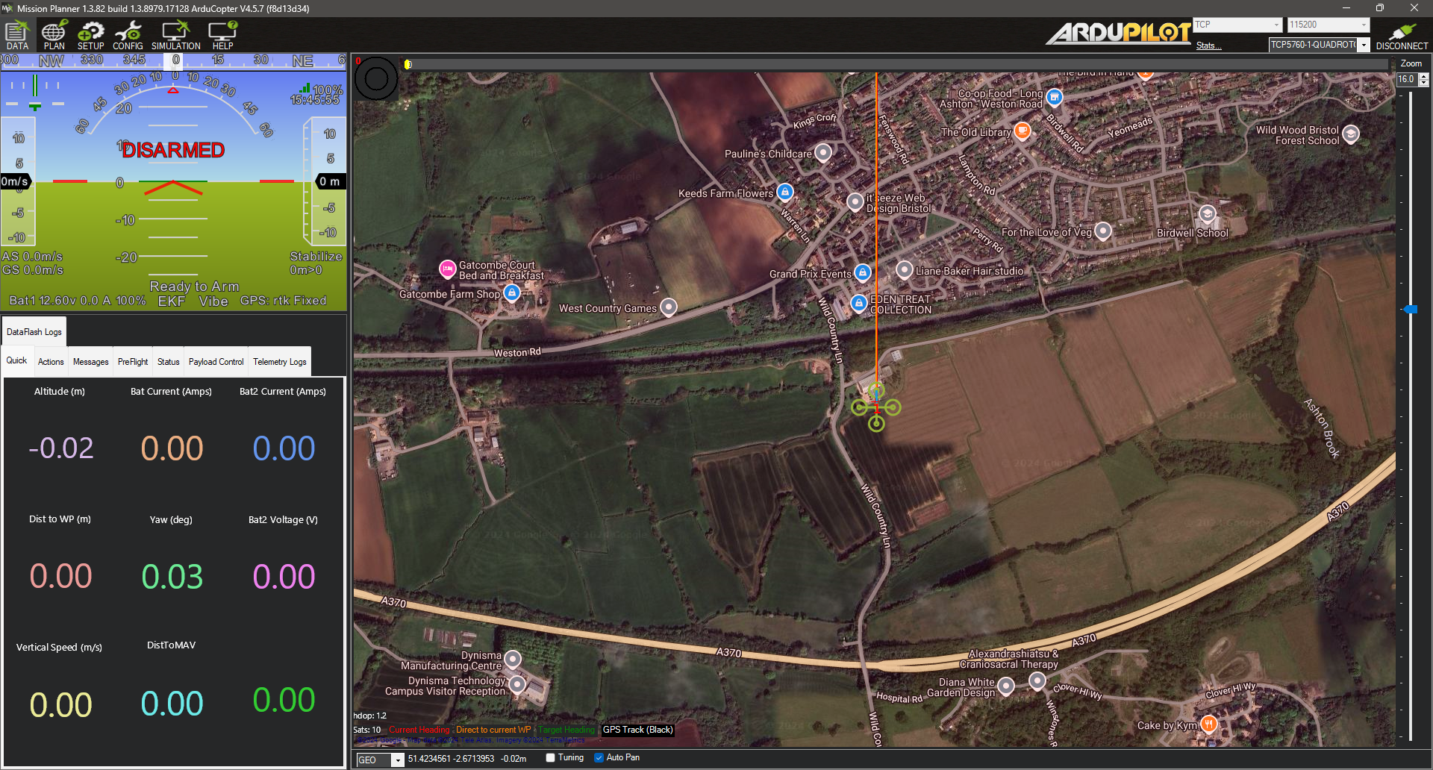
Mission Planner
Open Source.
Used to plan autonomous missions.
Can be used to setup UAVs and Autopilots
Wired and Wireless Telemetry.
Able to view and set current parameters.
Log error messages.
Simulated UAVs for development.

Slide 6
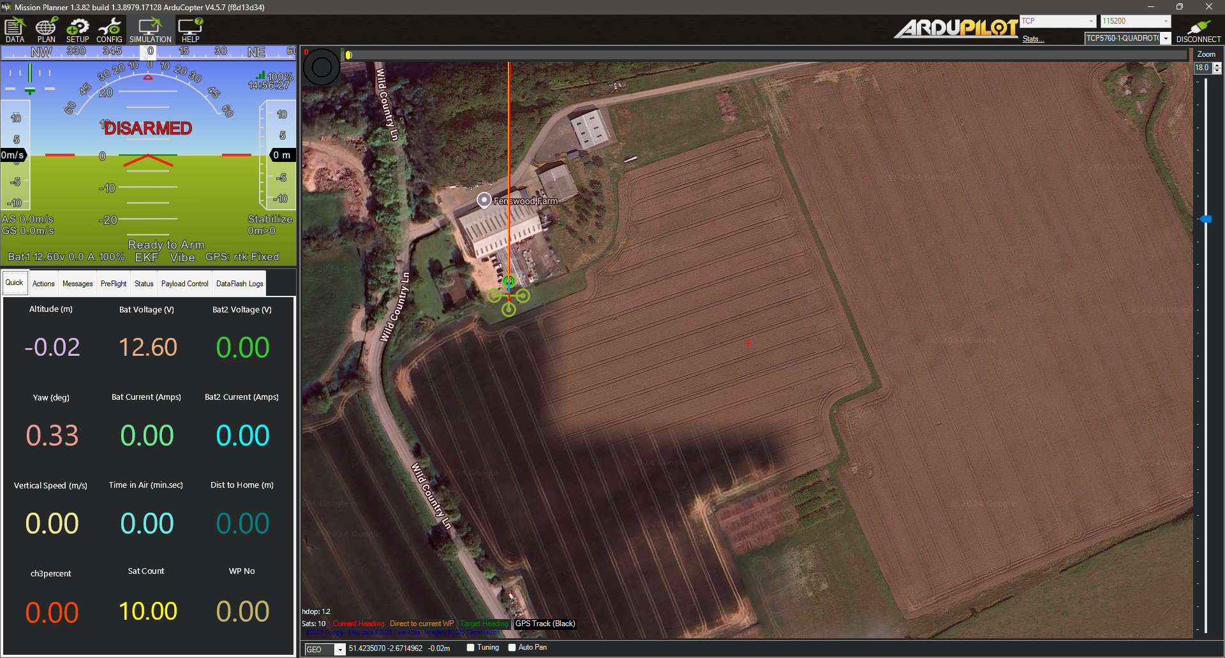
Navigation tabs
HUD:
Artificial Horizon
Speed & Heading
Altitude
Current Mode
Map Display:
Current Route Waypoints
Drone Position
Home Location
Movement Track
Multi-Tab Panel:
Quick-View Telemetry
UAV Control Buttons
Payload Gimbal Controls
Data Page

Slide 7
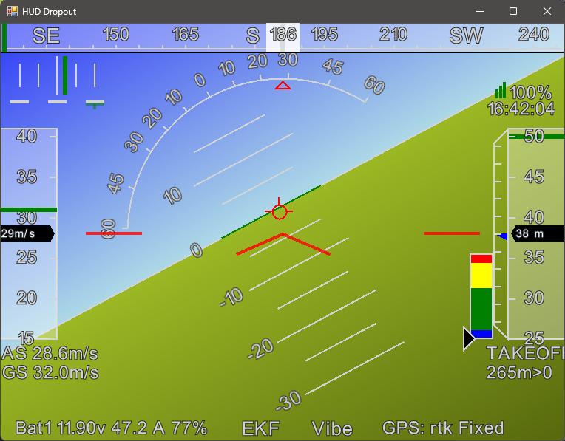
UAV Heading
Received Signal Strength Indicator (RSSI)
Altitude Indicator
Airspeed & Groundspeed
Battery Remaining Percentage, Voltage and Current Draw
Drone Positioning System Status Indicators
Head’s Up Display (HUD)

Slide 8
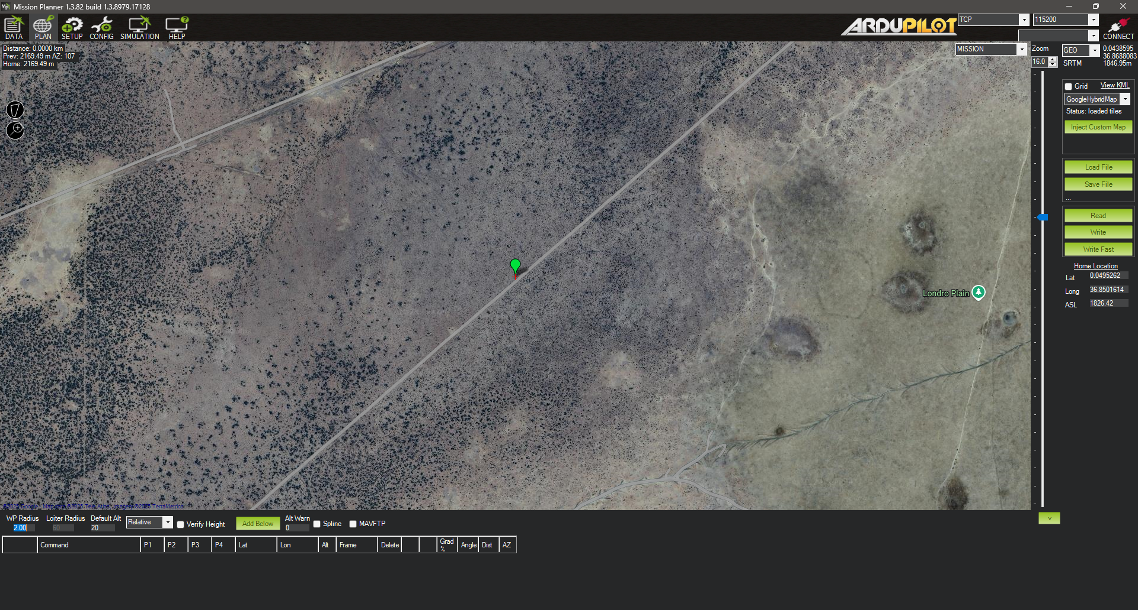
Import and Export of Waypoint Files
Mission Planner
Upload/Download Mission To/From UAV
Current Mission Waypoint Table
Planning Page

Slide 9
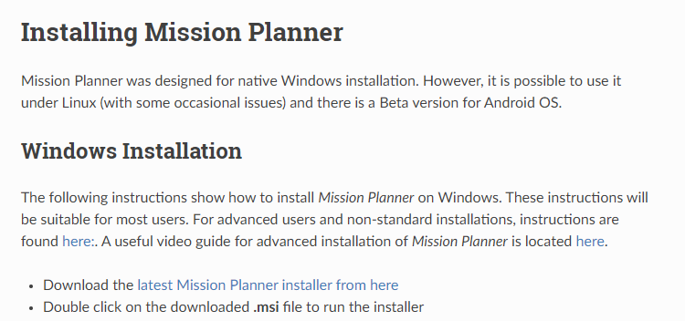
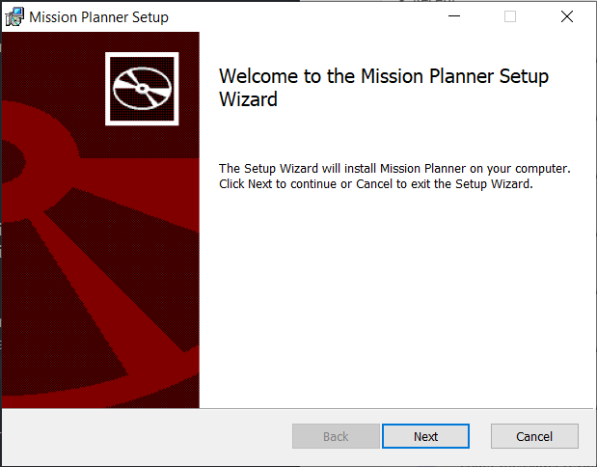
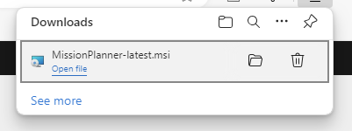
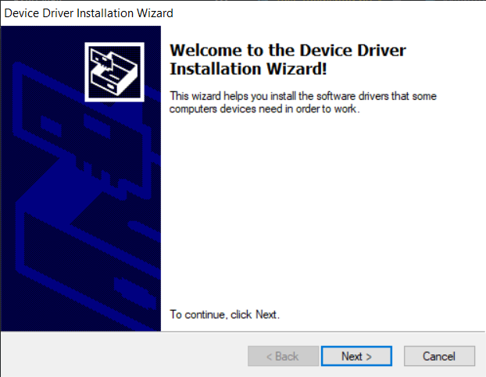
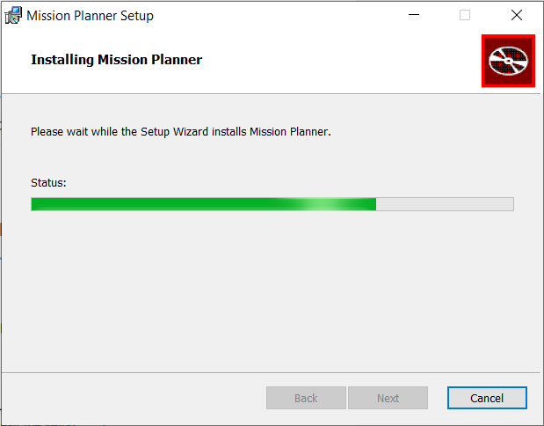
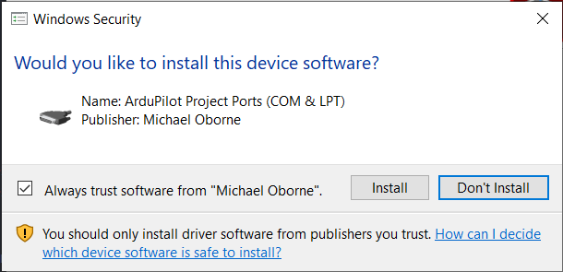
ardupilot.org/planner/docs/mission-planner-installation.html
Mission Planner Installation – NOTE: This is an EXTERNAL software – download at your own risk!

Slide 10
Bugfix Parameter File
meierkilian/ArdupilotIntro
Download “Plane.parm”
https://github.com/meierkilian/ArdupilotIntro

Slide 11
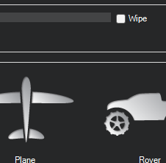
[SITL Waypoint Mission Demo]

Slide 12
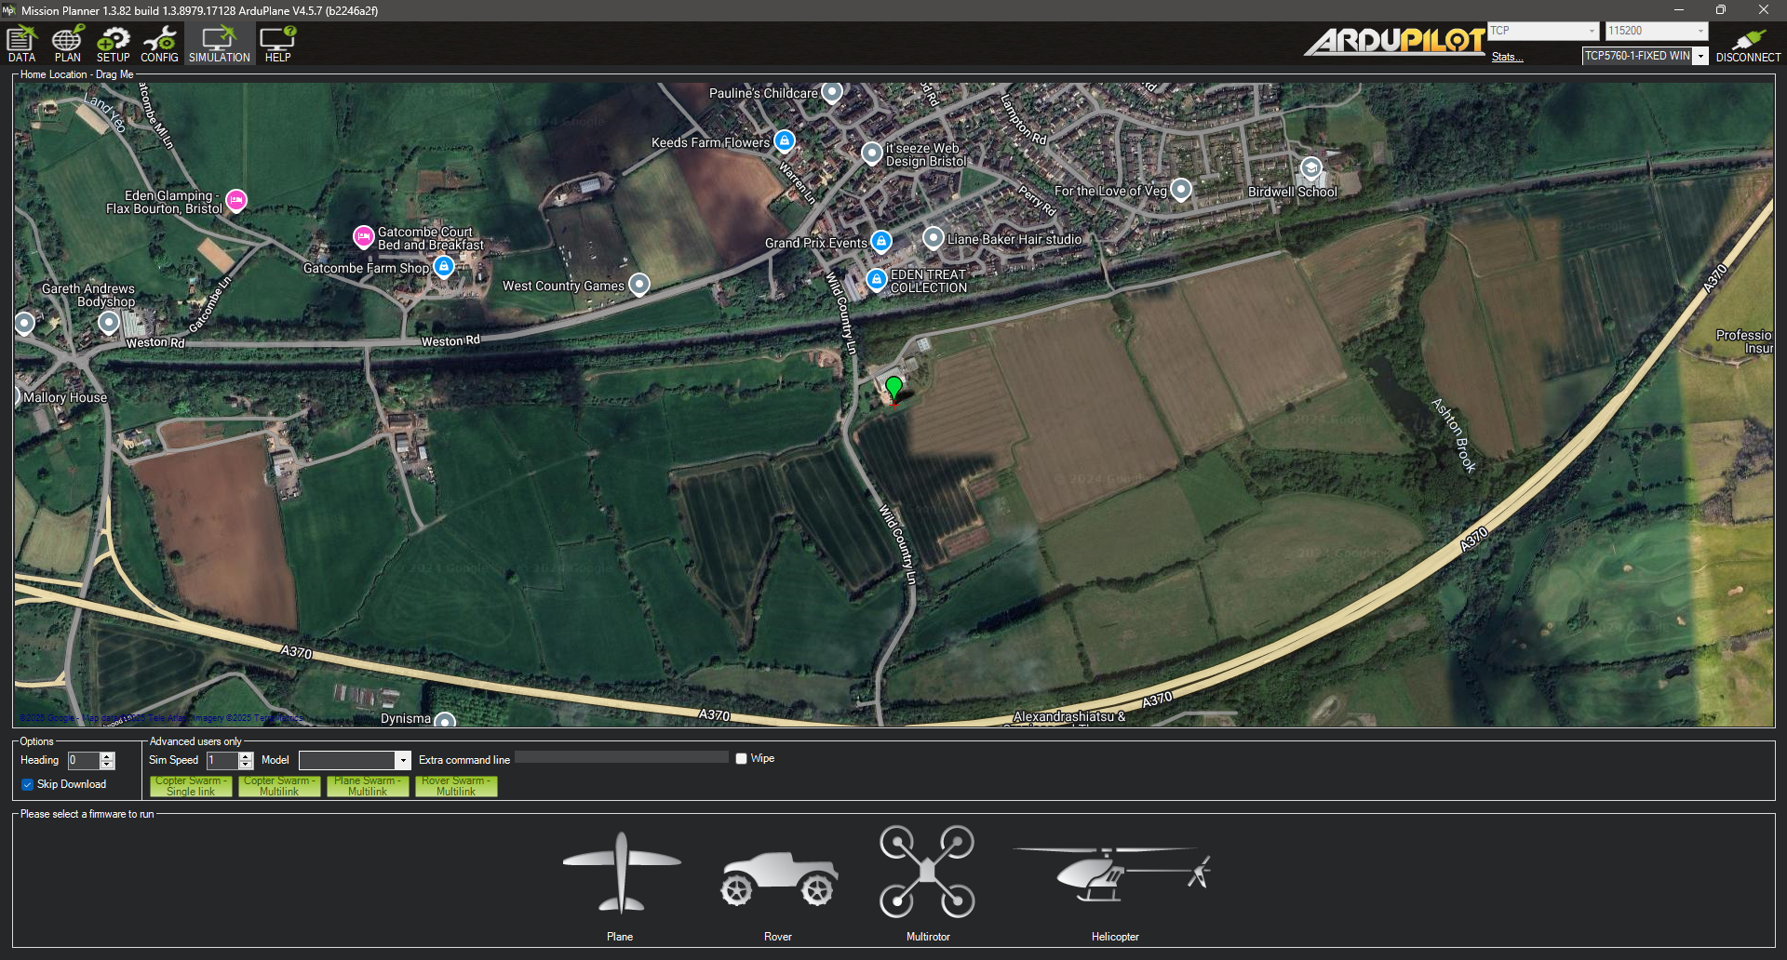
Simulation Setup
Select ‘Simulation’ from top tab
In Model, select ‘plane’
Click on the Plane
Select ‘Stable’ version
SITL will download and connect
Go to ‘Plan’ tab to create waypoints
Take off and control from ‘Actions’ menu
Quick display menu
Full status in Status Menu
Error messages in ‘Messages’ menu
ardupilot.org/planner/docs/mission-planner-simulation.html

Slide 13
Waypoint File Structure
QGC WPL 110
<INDEX> <CURRENT WP> <COORD FRAME> <COMMAND> <PARAM1> <PARAM2> <PARAM3> <PARAM4> <PARAM5/X/LATITUDE> <PARAM6/Y/LONGITUDE> <PARAM7/Z/ALTITUDE> <AUTOCONTINUE>
<INDEX> - Unique Index of Waypoint Starting from 0
<CURRENT WP> - Equal to 1 if the waypoint is the initial point, 0 Otherwise
<COORD FRAME> - Altitude Reference 3 – Relative to Home, 0 – Absolute, 10 - Relative to Terrain
<COMMAND> - Numerical Identifier of the “Command” to be performed
<PARAM1> - Parameter Dependent on Command
<PARAM2> - Parameter Dependent on Command
<PARAM3> - Parameter Dependent on Command
<PARAM4> - Parameter Dependent on Command
<PARAM5/X/LATITUDE> - X Coordinate of Waypoint (Lat.), based on CRF chosen
<PARAM6/Y/LONGITUDE> - Y Coordinate of Waypoint (Long.), based on CRF chosen
<PARAM7/Z/ALTITUDE> - Z Coordinate of Waypoint (Alt.), in metres
<AUTOCONTINUE> - Equal to 1 if the mission should automatically continue to the next waypoint

Slide 14
Mission Navigation Commands
Command | ID | PARAM 1 | PARAM 2 | PARAM 3 | PARAM 4
WAYPOINT | 16 | HOLD TIME [s] | ACCEPT RADIUS [m] | PASS RADIUS [m] | YAW [deg]
LOITER UNLIMITED | 17 |  |  | RADIUS [m] | YAW [deg]
LOITER TURNS | 18 | NUM TURNS | HEADING REQ. | RADIUS [m]
LOITER TIME | 19 | LOTER TIME [s] | HEADING REQ. | RADIUS [m]
RETURN TO LAUNCH | 20
LAND | 21 | ABORT ALT. [m] | LAND MODE |  | YAW [deg]
TAKEOFF | 22 | PITCH [deg] |  |  | YAW [deg]
LOITER TO ALT | 31 | HEADING REQ. | RADIUS [m]
VTOL TAKEOFF | 84 |  | HEADING [deg] |  | YAW [deg]
VTOL LAND | 85 | LAND OPTIONS |  | APPROAD ALT. [m] | YAW [deg]
SPLINE WAYPOINT | 82 | HOLD TIME [s]

Slide 15
Mission Action Commands
Command | ID | PARAM 1 | PARAM 2 | PARAM 3 | PARAM 4
SET MODE | 176 | MODE
CHANGE SPEED | 178 | SPEED TYPE | SPEED | SPEED [m/s]
MOUNT CONTROL* | 205 | PITCH [deg] | ROLL [deg] | YAW [deg] | ALTITUDE [m]
PAYLOAD PLACE | 94 | MAX DESCENT [m]
DO JUMP | 177 | WAYPOINT NUM. | REPEATS |  | YAW [deg]

Slide 16
Mission Planner Tasks
Task 1 – SITL Experimentation:
Using the SITL simulation. Load a plane.
Set the plane’s Mode to TAKEOFF and then arm the vehicle.
Experiment with enabling and disabling the aileron servo – how does the vehicle behave?
Can you disable the rudder as well, but this time using the parameter list?

Slide 17
Mission Planner Tasks
Task 2 – Waypoint Mission Planning:
Using the SITL you already have running, plan a mission which includes Take-off and Landing from the same location, and at least 4 standard waypoints.
You should take-off to 40m, and then ascend to 120m by the final waypoint.
Consider how you will make the aircraft descend and reach the landing point as accurately as possible

Slide 18
Mission Planner Tasks
Task 3 – Weather effects
Using the SITL you already have running have the plane takeoff and loiter at 100m.
Now set these two parameters in mission planner:
SIM_WIND_DIR = 60
SIM_WIND_SPD = 7.5
What do you notice about the loiter circle?
Now change SIM_WIND_TURB to 3
You should see that the “neat” loiter circle now varies a lot more.
Run the same mission you produced for task 2.
Reset these parameters to:
SIM_WIND_DIR = 180
SIM_WIND_SPD = 0
SIM_WIND_TURB = 0

Slide 19
Mission Planner Tasks
Task 4 – Sensor Failures
Restart the Plane SITL simulation.
Have the plane takeoff to 100m again.
Now Set:
SIM_GPS_DISABLE = 1
What happens?
Next:
SIM_GPS_DISABLE = 0
SIM_RC_FAIL = 1

Slide 20


Search Patterns – The Basics
Lawnmower
Spiral

